Slide 1
Applied Data Science Capstone
Elyse Hallstrom
Phoenix Restaurant location selection

Slide 2
Problem
Our client wants to know where to open a new American Restaurant in Phoenix, AZ so that they have the best chances of being successful.

Slide 3
Background
Our client is a well-known restauranteur in the US, but has no restaurants in Phoenix, AZ yet.
They would like to open a new American Restaurant.
They need to know where would be the best place to lease restaurant space.
Their American Restaurant will be on the pricier end of the spectrum, so they’d like to target people with higher incomes that can afford to eat there.
They also would like to be in an area where American Restaurants are popular so there is a proven track record of demand for that type of restaurant.

Slide 4
Audience
This methodology is of interest to any type of business that is looking to know where to open a location based on income level in that zip code.

Slide 5
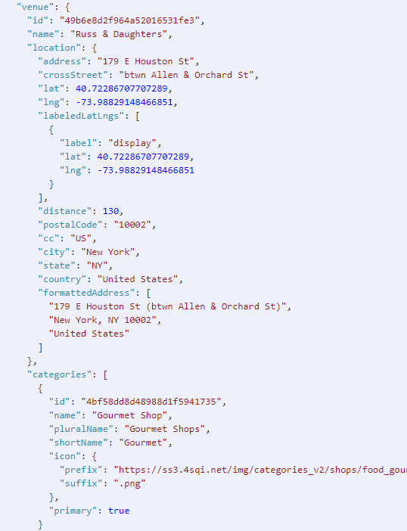
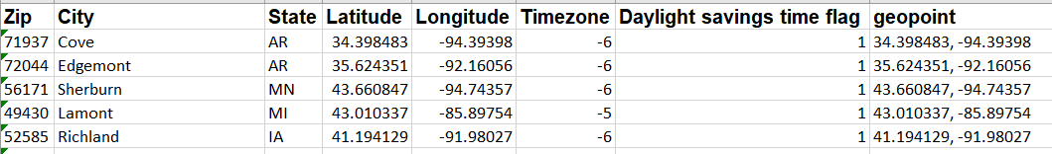
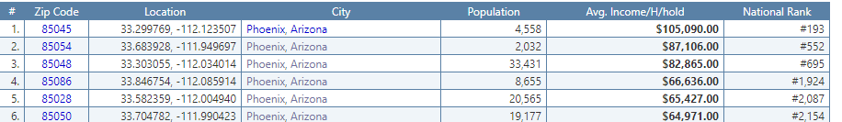
The Data
For the location data, we will use the Foursquare API explore to find the types of venues in each zip code.
We will use zip code data from Open Datasoft to get the longitude, latitude, and city for each zip code.
We will get the average household income by zip code from Zip Atlas.

Slide 6
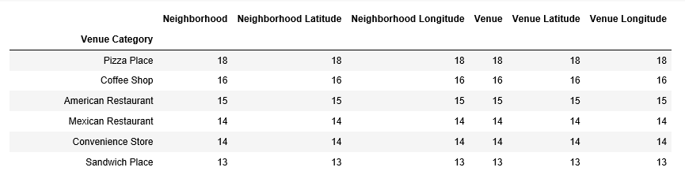
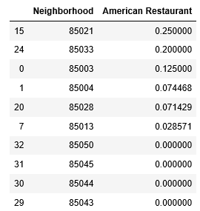
Data Exploration
Reviewed most popular venues in Phoenix
Top zip codes with highest average American Restaurants

Slide 7
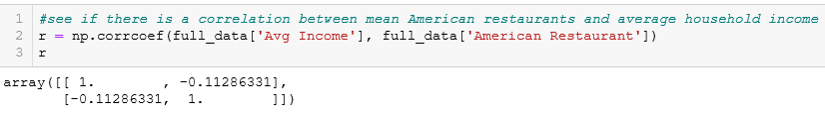
Methodology
Merged dataset together to have average household income, average venue density, and zip code data in one dataframe
R-squared coefficient between average American Restaurants and Average household income

Slide 8
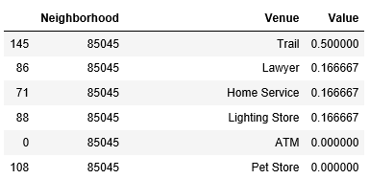
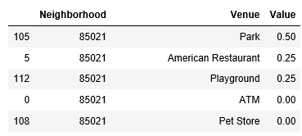
Results – Two Options for Location
Most affluent zip code has no restaurants at all.
Unclear if this is because there are no restaurant spaces or they have been unsuccessful
Need to do further research on historical restaurants to see if any have been opened here before and why they closed
Highest average American Restaurant zip code only has American Restaurants.
Looks like there is a park in that zip code and only American Restaurants
Most affluent zip with most popular venues
Most American Restaurants zip

Slide 9
Discussion
If we were able to find a dataset that grouped zip codes into neighborhoods, that might give us a more robust dataset to work from.
Would like to, in the future, look at the historical restaurant data in these two zip codes to help inform our decision on what kinds of restaurants have been most successful (longest lifespan)

Slide 10
Conclusion
Based on the request to determine where to build a new American Restaurant, we would recommend to our client to investigate zip codes 85021 and 85045.

